Slide 1
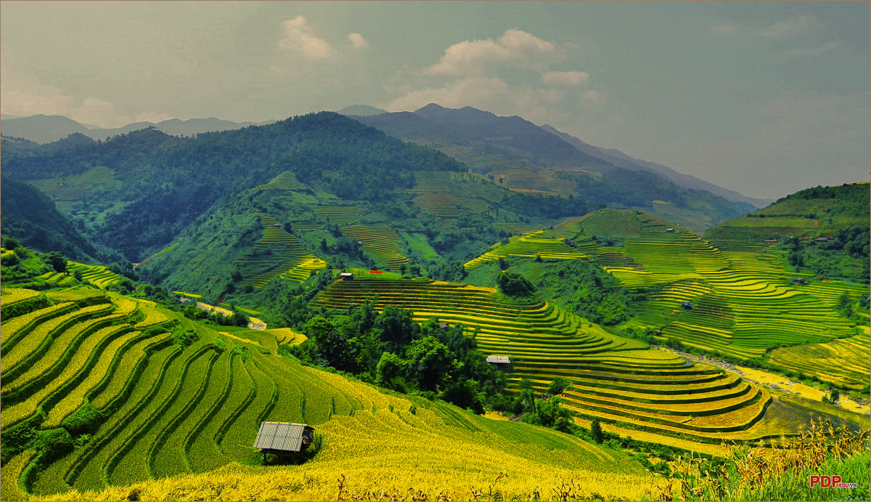
TECHNOLOGY IN AN INDIGENOUS CONTEXT PROJECT
PROJECT PRESENTATION
AND DEMONSTRATION
Team name: Skill-igenous
Group no.: 5
Members: Nguyen Ha Huy Hoang, Ta Quang Tung, Vu Minh Quang, Do Tuan Dat, Tran Khai Kiet

Slide 2
Overview
Team member | Role
Nguyen Ha Huy Hoang | Blockchain system for farmer - business contract
Ta Quang Tung | Mis/disinformation detection with deep learning
Vu Minh Quang | Recommendation system for training personalization
Tran Khai Kiet | Content auto-translation with transformer model
Do Tuan Dat | Voice search engine with BIMASR

Slide 3
Project background
Although the Vietnamese government has already implemented many agricultural training programs to help ethnic minorities catch up with current development, most of these programs are not returning good results. According to Nguyen Tung Phong, only 43.5% of the training knowledge is applied to reality, which suggests that the current vocational training approach is time-consuming and impractical. This project aims to solve this problem by developing a specialized information system for ethnic agricultural training. After extensive research, our team has identified five issues:
Impractical curriculum
Lack of business connection
Difficulty in searching learning content
Spread of unverified information
Language barrier

Slide 4
Project scope
Develop meaningful curricula for ethnic farmers.
Bridge businesses and farmers
Have the search engine optimized
Implement misinformation checking
Auto-translate learning content
Exclusion
Supporting people who are not working in agriculture
Tasks that involve the use of expensive hardware
AI functions that have low accuracy

Slide 5

DESIGN CONCEPT 1
Recommendation system for training personalization
LEARNING ISSUE
Only 14% of the total ethnic minority population are taking part in vocational training programs. Most ethnic workers believe that vocational training is time-consuming.
Learners are more likely to take short-term classes instead of a 3-month course with full training content.
🡺 Since vocational training is failing to meet the needs and expectations of ethnic learners, the solution is to personalize training using a recommendation system.

Slide 6
DESIGN CONCEPT 1
Recommendation system for training personalization
DESIGN OUTLINE
A recommendation system is an expert system that gives recommendations based on input data.
The system will collect data from farmers or IOT sensors and then produce advice based on that information.
The system will make recommendations based on 3 sources of information: soil, environment, and weather.
This information will be preprocessed then fed into a machine learning model to make visualized recommendation on a map. ANN (artificial neural network) will be the best machine learning algorithm for this model.

Slide 7
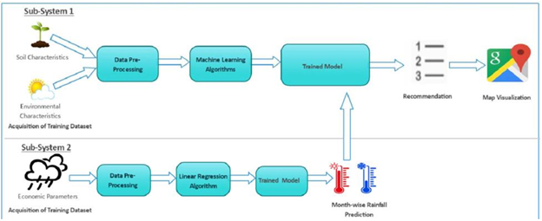
DESIGN CONCEPT 1
Recommendation system for training personalization
DESIGN OUTLINE

Slide 8
DESIGN CONCEPT 1
Recommendation system for training personalization
DESIGN BENEFITS
Farmers will get recommendations on which plants and animals can be cultivated on their land, helping them to reap the most benefits.
The system will also give farmers daily recommended tasks to do to ensure that their plants and animals are raised in best condition.

Slide 9
DESIGN CONCEPT 1
Recommendation system for training personalization
ESTIMATION OF BUDGET
Type | Detail | Monthly costs
Equipment | Cloud Architecture (EC2, ECS and SageMaker) | $422.42 (623.68 AUD)
 | Sensor (x50) | $1550 (2288.51 AUD)
Labor | Cloud Architect (x1) | 28.900.000 VND ( 1789.26 AUD)
 | IOT engineer (x1) | 13.000.000 VND (805 AUD)
 | Manager (x1) | 35.000.000 VND (2167.94 AUD)
 | Machine learning engineers (x1) | 28.900.000 VND (1790 AUD)
 | Data analyst (x1) | 10.208.000 VND (632.30 AUD)
 | Office (100m², with electricity and Wi-Fi coverage) | 117.500.000 VND (7381.54 AUD)
Total |  | 17478.23 AUD (280,139,643 VND)
Cost over the entire project (3 months): 840,418,929 VND

Slide 10

DESIGN CONCEPT 2
Mis/disinformation detection with deep learning
LEARNING ISSUE
Mis/disinformation can have disastrous effects on communities.
Factors that promote mis/disinformation spread: use of social media, fast publication, low information literacy.
Our current information system allows the spread of mis/disinformation because anyone can upload learning content.
🡺 Some mis/disinformation detection mechanism is necessary

Slide 11
DESIGN CONCEPT 2
Mis/disinformation detection with deep learning
DESIGN OUTLINE
The detector is based on a framework developed for misleading COVID-19 TikTok videos.
Analyzes the visual and audio features separately, then fuses them into a vector representation capturing the relationship between the frames and speech words.
Implemented with the PyTorch library on Amazon SageMaker.
Uploaded videos are checked before going into the database.
Misleading uploads can result in warnings, penalties, or permanent bans. Users can request a re-verification by human professionals to account for inaccuracy.

Slide 12
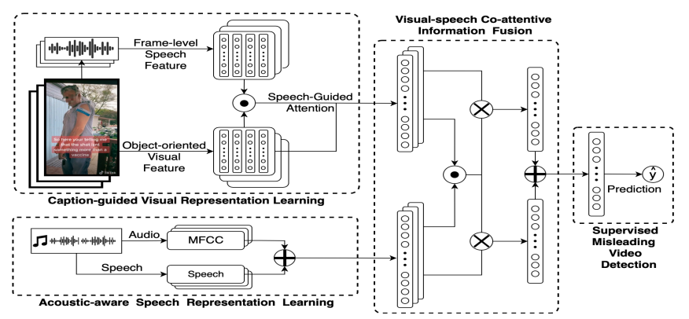
DESIGN CONCEPT 2
Mis/disinformation detection with deep learning
DESIGN OUTLINE

Slide 13
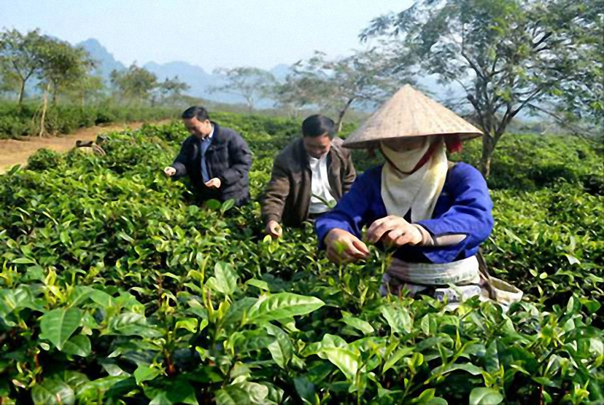
DESIGN CONCEPT 2
Mis/disinformation detection with deep learning
DESIGN BENEFITS
Ensures that our information system will remain useful for ethnic users looking for agricultural knowledge.
Prevents bad actors from spreading misleading content which can have serious consequences on ethnic communities.

Slide 14
DESIGN CONCEPT 2
Mis/disinformation detection with deep learning
ESTIMATION OF BUDGET
Type | Detail | Monthly costs
Equipment | Cloud Architecture (EC2, ECS and SageMaker) | $422.42 (623.68 AUD)
Labor | Cloud Architect (x1) | 28.900.000 VND ( 1789.26 AUD)
 | Manager (x1) | 35.000.000 VND (2167.94 AUD)
 | Machine learning engineers (x2) | 57.800.000 VND (3580 AUD)
 | Office (100m², with electricity and Wi-Fi coverage) | 117.500.000 VND (7381.54 AUD)
Total |  | 249,126,512 VND (15542.42 AUD )
Cost over the entire project (3 months): 747,379,536 VND

Slide 15

DESIGN CONCEPT 3
Content auto-translation with transformer model
LEARNING ISSUE
Only 80.9% of the ethnic population knows Vietnamese (GSO, 2019), meaning one out of five people gets alienated due to language.
The current agriculture training knowledge is available mostly in Vietnamese. Ethnic learners who are not proficient in Vietnamese cannot peruse this content.
The learning content in our information system must also be available in ethnic languages to allow equal access.
🡺 An auto-translation for uploaded content is necessary.

Slide 16
DESIGN CONCEPT 3
Content auto-translation with transformer model
DESIGN OUTLINE
Features a parallel dual-decoder Transformer to read the video transcript at the same time as translating it.
An input layer will read the video transcript and forward it into the transformer model.
The transformer model will utilize the attention mechanism for natural language processing to boost performance on large datasets.
Unfortunately, the maximum accuracy yielded by this model is only 67%, since it has to simultaneously read the video transcript and translate it.

Slide 17
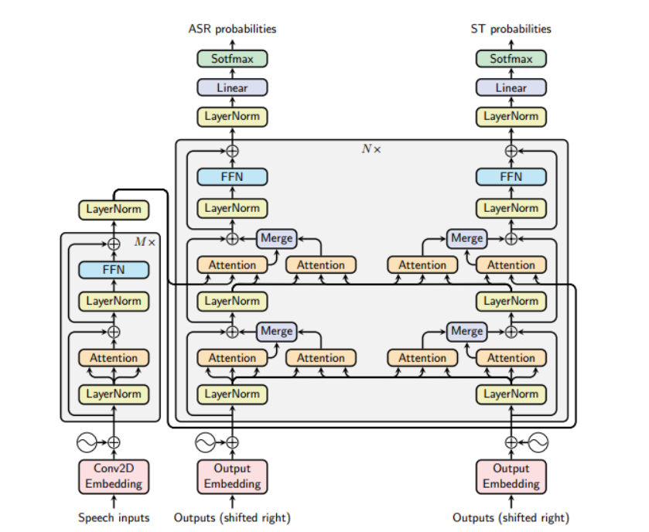
DESIGN CONCEPT 3
Content auto-translation with transformer model
DESIGN OUTLINE

Slide 18
DESIGN CONCEPT 3
Content auto-translation with transformer model
DESIGN BENEFITS
Improve accessibility for ethnic minorities.
Bring existing training materials closer to ethnic minorities that are not fluent in Vietnamese.
Result in a more inclusive learning platform.
Integrates seamlessly with the search engine feature mentioned later, allowing ethnic users to search for content in their native languages.

Slide 19
DESIGN CONCEPT 3
Content auto-translation with transformer model
ESTIMATION OF BUDGET
Type | Detail | Monthly costs
Equipment | Cloud Architecture (EC2, ECS and SageMaker) | $422.42 (623.68 AUD)
 | GPU Tesla T4 (x5) | $5900 (8757.05 AUD)
Labor | Cloud Architect (x1) | 28.900.000 VND ( 1789.26 AUD)
 | Manager (x1) | 35.000.000 VND (2167.94 AUD)
 | Machine learning engineers (x1) | 28.900.000 VND (1790 AUD)
 | Office (100m², with electricity and Wi-Fi coverage) | 117.500.000 VND (7381.54 AUD)
Total |  | 330,166,375 VND (20720.21 AUD)
Cost over the entire project (3 months): 990,499,125 VND

Slide 20

DESIGN CONCEPT 4
Voice search engine with BIMASR
LEARNING ISSUE
According to Nisansala Vidanapthirana, poor rural areas are likely to have a high illiteracy rate, which hinders farmers’ access to quality training content.
This is also true for the mountainous areas where learning opportunities are scarce.
Due to low literacy, ethnic users of our information system might not know how to search for content by text.
🡺 Our system should be equipped with a voice search function implementing machine learning.

Slide 21
DESIGN CONCEPT 4
Voice search engine with BIMASR
DESIGN OUTLINE
Implement the BIMASR (Building Information Modeling Automatic Speech Recognition) framework to support the system with voice searching. It consists of 3 parts.
The first part is the Speed-2-text module, which runs an API call to Google Cloud API (which can reach up to 97% accuracy for speed-2-text tasks)
The second part will be the query forming module where the extracted input text will be analyzed and used to form a query before being sent to the database.
The final part is the data retrieving module where the query from part 2 will be run and proper information from the database will be returned.

Slide 22
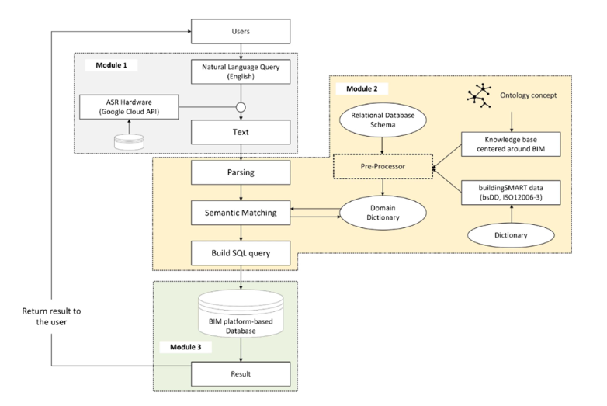
DESIGN CONCEPT 4
Voice search engine with BIMASR
DESIGN OUTLINE

Slide 23
DESIGN CONCEPT 4
Voice search engine with BIMASR
DESIGN BENEFITS
Streamlines the search process of the system.
Allows ethnic users to find information more easily.
Allows people with low literacy to find the information they need.

Slide 24
DESIGN CONCEPT 4
Voice search engine with BIMASR
ESTIMATION OF BUDGET
Type | Detail | Monthly costs
Equipment | Cloud Architecture (EC2, ECS and SageMaker) | $422.42 (623.68 AUD)
 | Database | $846 (1248.96 AUD)
Labor | Cloud Architect (x1) | 28.900.000 VND ( 1789.26 AUD)
 | Manager (x1) | 35.000.000 VND (2167.94 AUD)
 | Machine learning engineers (x1) | 28.900.000 VND (1790 AUD)
 | Data engineer (x1) | 34.746.041 VND (2152.21 AUD)
 | Office (100m², with electricity and Wi-Fi coverage) | 117.500.000 VND (7381.54 AUD)
Total |  | 17153.59 AUD (274,936,339 VND)
Cost over the entire project (3 months): 824,809,017 VND

Slide 25

DESIGN CONCEPT 5
Blockchain system for farmer - business contract
LEARNING ISSUE
For a long time, there has been a weak connection between ethnic farmers and private sectors since there are many hindrances that prevent them from working together (such as the market price, logistic costs,…).
Ethnic farmers are separated from the supply chain of the whole country, reducing their income.
🡺 Blockchain technology can be used to establish contracts between farmers and businesses, connecting these parties.

Slide 26
DESIGN CONCEPT 5
Blockchain system for farmer - business contract
DESIGN OUTLINE
The system will be implemented on the cloud.
Businesses will place orders on the system. Farmers will get the orders and sign contracts, which will be put into a blockchain system. Breaching the contract will damage the breacher’s reputation.

Slide 27
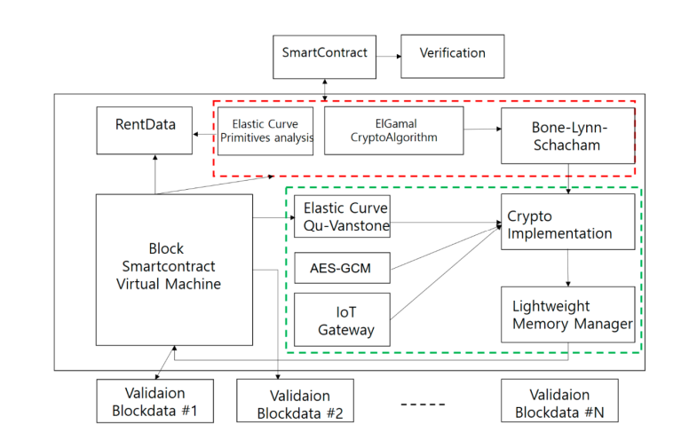
DESIGN CONCEPT 5
Blockchain system for farmer - business contract
DESIGN OUTLINE

Slide 28
DESIGN CONCEPT 5
Blockchain system for farmer - business contract
DESIGN OUTLINE
The red block provide encryption to protect the information within the system.
The green block will ensure that the encryption is working before putting it into blocks.
There is also a smart contract component to check if the input data satisfy the requirements for the contracts or not.

Slide 29


DESIGN CONCEPT 5
Blockchain system for farmer - business contract
DESIGN BENEFITS
For farmers:
The private sector will better understand the farmers.
Help farmers to build their reputation.
For businesses:
Gain access to high quality farmers.
Reliable material sources even for rare materials.

Slide 30
DESIGN CONCEPT 5
Blockchain system for farmer - business contract
ESTIMATION OF BUDGET
Type | Detail | Monthly costs
Equipment | Cloud Architecture (EC2, ECS and SageMaker) | $422.42 (623.68 AUD)
Labor | Cloud Architect (x1) | 28.900.000 VND ( 1789.26 AUD)
 | Blockchain engineer (x1) | 14,900,000 VND (922.92 AUD)
 | Manager (x1) | 35.000.000 VND (2167.94 AUD)
 | Machine learning engineers (x1) | 28.900.000 VND (1790 AUD)
 | IT security (x1) | 21.900.000 VND (1356.51 AUD)
 | Office (100m², with electricity and Wi-Fi coverage) | 117.500.000 VND (7381.54 AUD)
Total |  | 16031.85 AUD (256,957,182 VND)
Cost over the entire project (3 months): 770,871,546 VND

Slide 31
Conclusion
Our team believe that the ideas above will be the key to solve the problems of the mountainous farmers, bringing knowledge to them and unlock their potential

Slide 32
Thank you!
Please ask us any questions!

